Slide 1
PROTECTING THE NATION’S MARINE WEALTH IN THE WEST PHILIPPINE SEA
Philippine Women’s Judges Association
6 March 2014
Justice Antonio T. Carpio

Slide 2
Protecting the nation’s maritime wealth in the West Philippine Sea
Our 1987 Constitution mandates:
    The State shall protect the nation’s marine wealth in its xxx exclusive economic zone, and reserve its use and enjoyment exclusively to Filipino citizens.
This is the mandate of the Constitution that we have all solemnly sworn to uphold.
To fulfill the State’s obligation to protect its marine wealth in its exclusive economic zone in the West Philippine Sea (WPS), the Philippine Government filed an arbitration case against China under the United Nations Convention on the Law of the Sea (UNCLOS).

Slide 3
Protecting the nation’s maritime wealth in the West Philippine Sea
UNCLOS is the primary international law on the use of oceans and seas of our planet. UNCLOS, which took effect in 1994, has 165 member states, comprising 85% of the membership of the United Nations.
UNLCOS governs the use of maritime zones, namely:
  Internal waters or archipelagic waters, the landward waters adjacent to the territorial sea;
  Territorial Sea, an area of 12 NM from baselines along the coast;
  Exclusive Economic Zone (EEZ), an area of 200 NM from the baselines;
  Extended Continental Shelf (ECS), an additional area of 150 NM from the outer limits of the EEZ; and
  The AREA, called the common heritage of mankind, beyond the ECS.

Slide 4
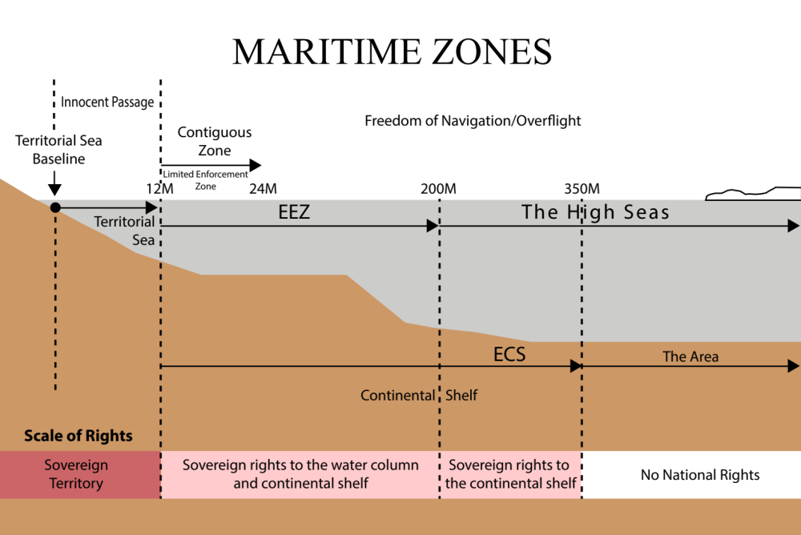
Maritime Zones

Slide 5
Protecting the nation’s maritime wealth in the West Philippine Sea
UNCLOS governs only MARITIME disputes, not TERRITORIAL disputes between or among states. Territorial disputes are sovereignty or ownership issues over land territory, like islands or rocks above water at high tide. Rocks below water at high tide are not land, and disputes over such rocks are maritime disputes, not territorial disputes.

Slide 6
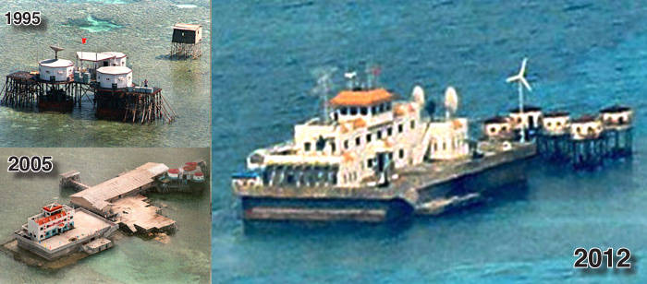
Mischief Reef (Panganiban)

Slide 7
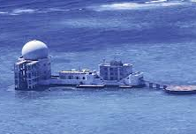
Subi Reef

Slide 8
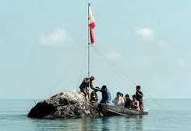
Scarborough Shoal (Panatag)

Slide 9
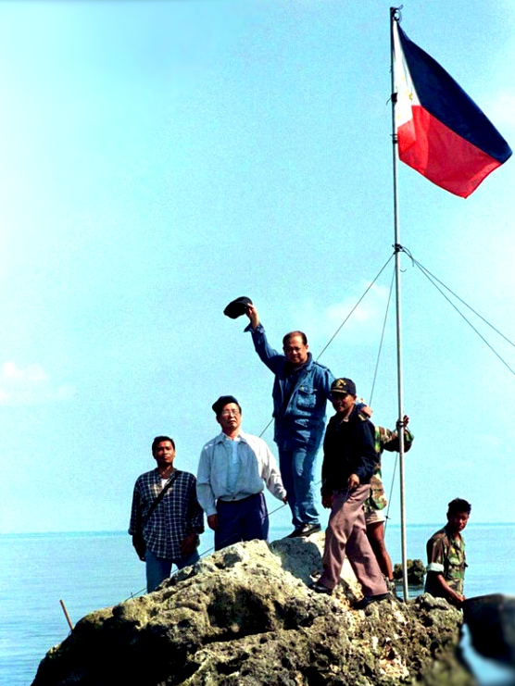
Scarborough
Shoal
(Panatag)

Slide 10
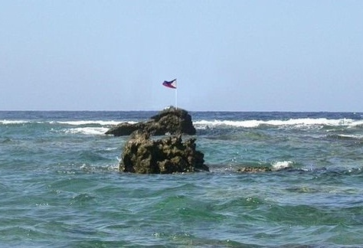
Scarborough Shoal (Panatag)

Slide 11
Protecting the nation’s maritime wealth in the West Philippine Sea
UNCLOS provides for a compulsory dispute settlement over maritime disputes among its members, including any dispute involving the interpretation or application of the provisions of UNCLOS. A state may opt out of certain specified disputes like sea boundary delimitation disputes involving OVERLAPPING territorial seas, EEZs or ECSs. The Philippines, China and all the other disputant states in the South China Sea are parties to UNCLOS, and are therefore bound by the UNCLOS compulsory dispute settlement mechanism.
Maritime disputes are governed primarily by UNCLOS, while territorial disputes are governed by the general rules and principles of international law. Under UNCLOS, member states gave their consent in advance to compulsory arbitration of maritime disputes. In territorial disputes, the disputant states must give their consent to each arbitration, unless they have given in advance their consent in a treaty. There is no such treaty between the Philippines and China involving compulsory arbitration of territorial disputes.

Slide 12
Protecting the nation’s maritime wealth in the West Philippine Sea
The Philippines’ arbitration case against China is solely a maritime dispute. The Philippines is asking the tribunal –
  Whether China’s 9-dashed line claim can negate the Philippines’ EEZ as guaranteed under UNCLOS;
  Whether certain rocks above water at high tide, like Scarborough Shoal, generate a 200 NM EEZ or only a 12 NM territorial sea;
  Whether China can appropriate Low-Tide-Elevations (LTEs) within the Philippines’ EEZ.
These issues involve the interpretation or application of the provisions of UNCLOS. The Philippines is not asking the tribunal to delimit by nautical measurements overlapping EEZs between China and the Philippines. The Philippines is not asking the tribunal what country has sovereignty or ownership over an island, or rock above water at high tide, in the West Philippine Sea.

Slide 13
Protecting the nation’s maritime wealth in the West Philippine Sea
Under UNCLOS, every coastal state is entitled to a 200 NM EEZ, subject to boundary delimitation in case of overlapping EEZs with other coastal states. The EEZ extends to 200 NM from the BASELINES of continental land or habitable island of a coastal state. The coastal state has exclusive “sovereign rights” to exploit all the living and non-living resources within its EEZ. Under UNCLOS, the EEZ must be drawn from baselines along the coast of continental land or an island capable of human habitation of its own.

Slide 14
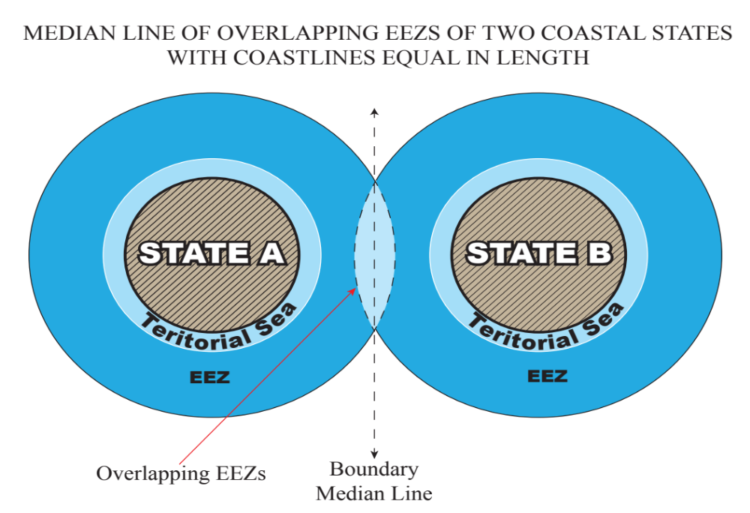
Median Line of Overlapping EEZs

Slide 15
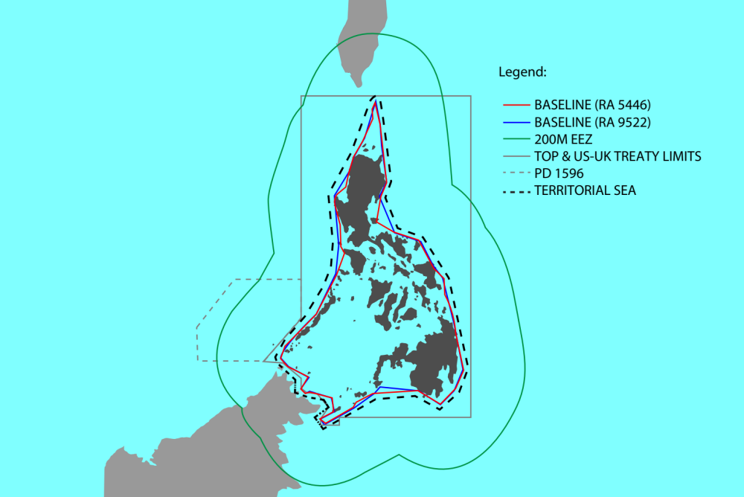
EEZ, Territorial Sea and Archipelagic Waters of Philippines

Slide 16
Protecting the nation’s maritime wealth in the West Philippine Sea
China claims almost 90% of the South China Sea under its 9-dashed line map, which overlaps 80% of the Philippines’ EEZ in the WPS. If China’s claim is upheld, the Philippines will lose 80% of its EEZ in the WPS, including the Reed Bank and the Malampaya gas fields.

Slide 17
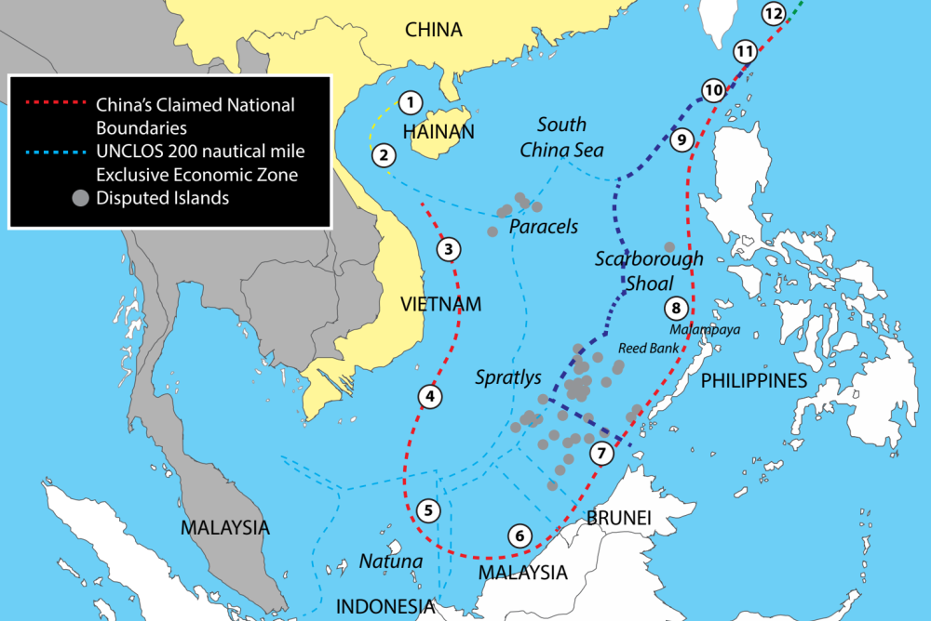
9-Dashed Lines Overlap Phil EEZ

Slide 18
Protecting the nation’s maritime wealth in the West Philippine Sea
The maritime dispute between the Philippines and China boils down to whether there are overlapping EEZs between the Philippines and China in the WPS. Are the waters enclosed by China’s 9-dashed lines part of China’s EEZ such that China’s EEZ overlaps with the Philippines’ EEZ in the WPS? China also claims that the islands in the Spratlys like Itu Aba generate their own EEZs which overlap with the Philippines’ EEZ in Palawan.
China claims that the arbitral tribunal has no jurisdiction over the Philippines’ claim for two reasons:
  a. The dispute involves overlapping EEZs between the Philippines and China, a dispute that China has opted out of compulsory arbitration;
  b. China’s 9-dashed line claim is a historical right that predates UNCLOS and cannot be negated by UNCLOS.

Slide 19
Protecting the nation’s maritime wealth in the West Philippine Sea
The Philippines’ response is that the waters enclosed within China’s 9-dashed lines do not constitute an EEZ because the 9-dashed lines are not drawn from baselines along the coast of continental land or island capable of human habitation of its own. Under UNCLOS, EEZs can be drawn only from baselines along the coast.
China has no EEZ that overlaps with the Philippines’ EEZ in the Scarborough area. China’s baselines are either along the coast of Hainan Island, 580 NM away from Luzon, or along the coast of mainland China, 485 NM from the Zambales coastline fronting Scarborough in Luzon. To have overlapping EEZs, the distance between the opposite baselines must be less than 400 NM. In the Scarborough area, there is no baseline in Luzon where the distance from the nearest Chinese baseline is less than 400 NM.

Slide 20

9-Dashed Lines and Different EEZs

Slide 21
Protecting the nation’s maritime wealth in the West Philippine Sea
Low-Tide-Elevations (LTEs) are rocks above water at low tide but below water, that is, submerged at high tide. LTEs are not land but part of the submerged continental shelf. Under UNCLOS, LTEs beyond the territorial sea are not capable of appropriation by any state. As part of the submerged continental shelf, LTEs beyond the territorial sea but within the EEZ of a coastal state are subject to the “sovereign rights” of such coastal state.
LTEs in the Spratlys within the 200 NM EEZ of the Philippines, like Mischief Reef or Subi Reef, are subject to the “sovereign rights” of the Philippines. Under UNCLOS, only the Philippines can construct structures on LTEs within its EEZ.

Slide 22
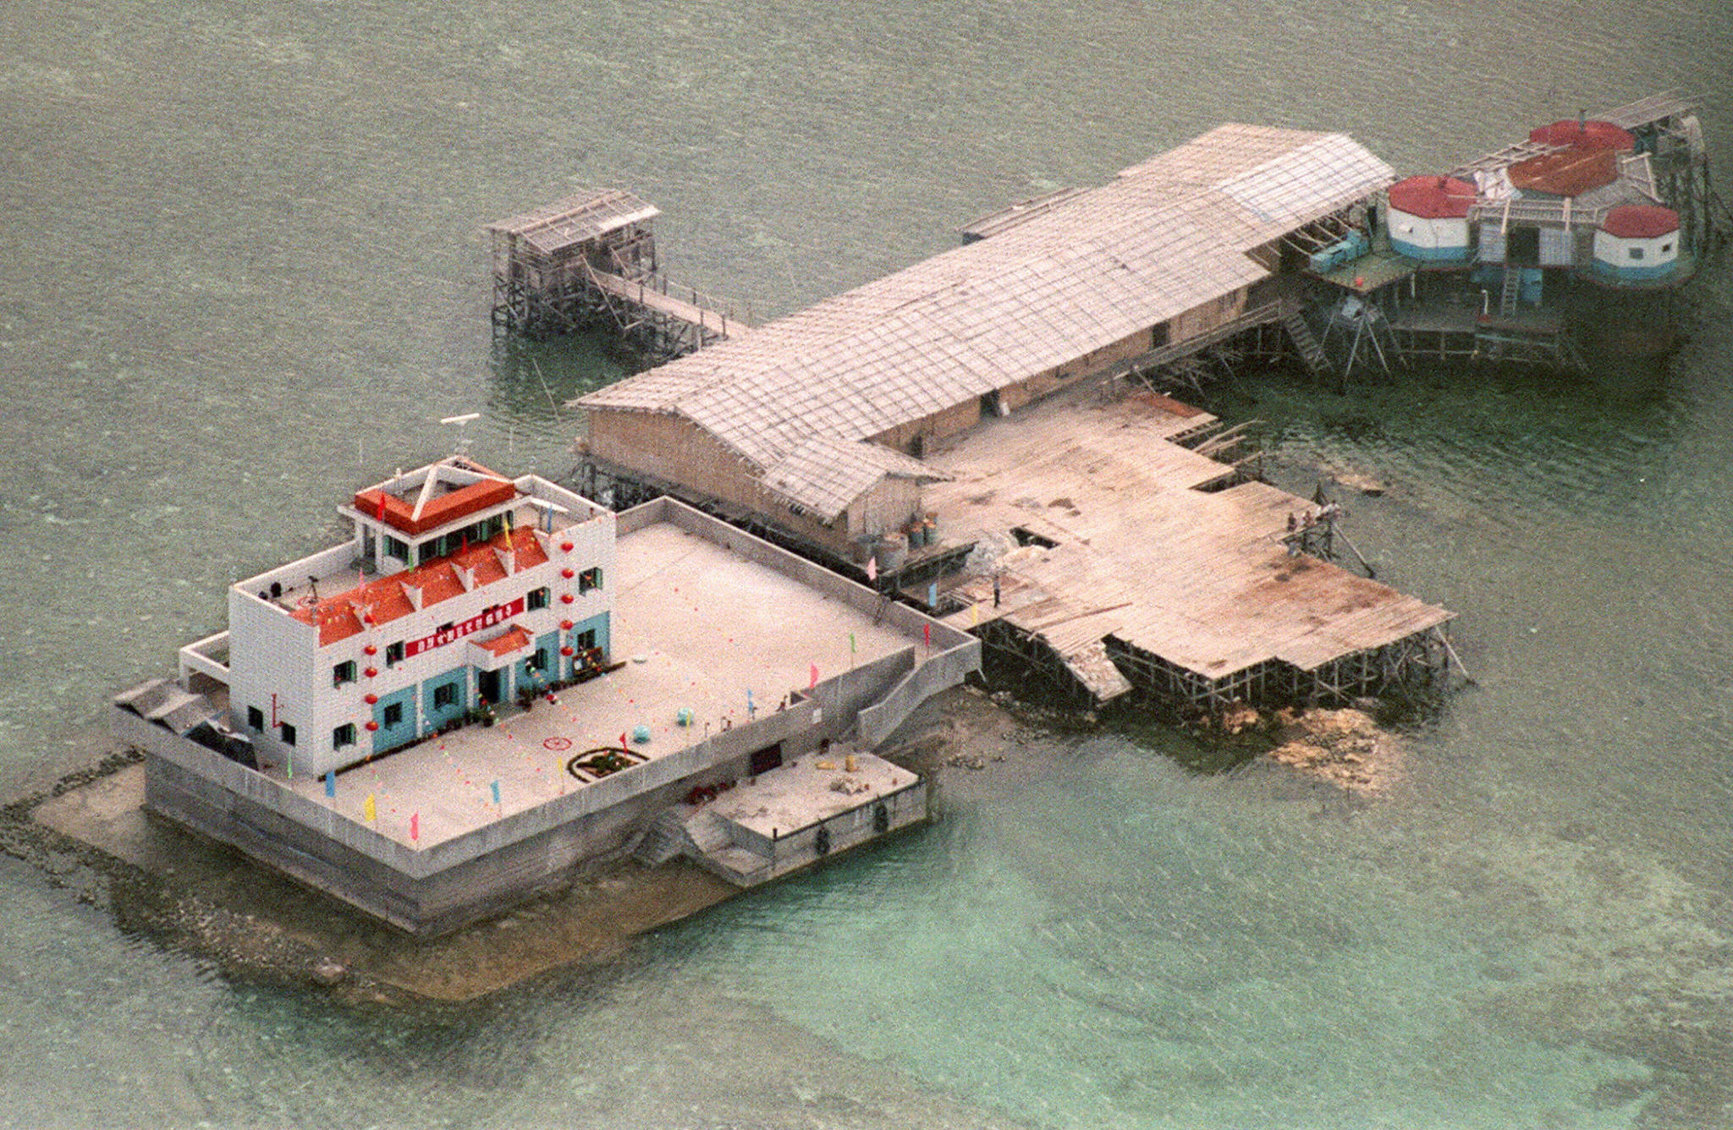
Mischief Reef (Panganiban)

Slide 23
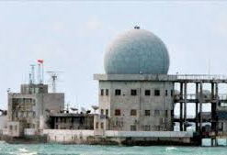
Subi Reef

Slide 24
Protecting the nation’s maritime wealth in the West Philippine Sea
Scarborough Shoal is not an LTE because it has 3 to 4 rocks that protrude not more than 2 meters above water at high tide. The rocks have no vegetation and obviously cannot sustain human habitation or economic life of its own. As a non-habitable “island”, Scarborough Shoal generates only a 12 NM territorial sea. Contrary to China’s claim, Scarborough Shoal cannot generate an EEZ. The Philippine position is that whoever owns Scarborough Shoal, whether the Philippines or China, the rocks can only generate a 12 NM territorial sea. Thus, Scarborough Shoal has no overlapping EEZ with the EEZ of Luzon.
In the Spratlys, with the exception of China, all the disputant states, namely the Philippines, Vietnam, and Malaysia, agree that none of the islands in the Spratlys generates an EEZ. The largest island, Itu Aba, has a land area of only 37.7 hectares and a coastline of 1.0 KM. Palawan, the largest Philippine province, has a land area of 1,489,655 hectares and an opposing coastline of 650 KM. Palawan’s coastline is 650 times longer and its land area 39,513 times larger than those of Itu Aba. The distance between Itu Aba and Palawan is 250 NM.

Slide 25
Protecting the nation’s maritime wealth in the West Philippine Sea
Under UNCLOS, to generate an EEZ an island must be capable of human habitation or economic life of its own. The soldiers stationed in Itu Aba cannot survive without periodic supplies from Taiwan. In the law of the sea jurisprudence, there are many islands bigger than Itu Aba that have been denied EEZs opposite a mainland or a much larger island.
Even if Itu Aba generates an EEZ, the UNCLOS rule of ensuring an “equitable solution” in maritime boundary delimitation prohibits substantial disproportion in the allocation of EEZs based on the length of the opposite coastlines. The opposite coastline of Itu Aba is 1 KM while that of Palawan is 650 KM. The rule of “equitable solution” in opposite coastlines will give Itu Aba a proportionally smaller EEZ as opposed to Palawan’s EEZ. The best-case scenario for Itu Aba is an EEZ of 50 NM facing Palawan, while Palawan will have a full EEZ of 200 NM facing Itu Aba. Itu Aba may also be given a longer EEZ facing the South China Sea away from Palawan.
If an arbitral tribunal rules that Itu Aba is capable of human habitation or economic life of its own and thus generates an EEZ, the tribunal will have no jurisdiction to proceed further without the consent of China. The arbitral tribunal cannot rule on the extent of such EEZ vis-à-vis the Philippine EEZ in Palawan, for that will involve a maritime boundary delimitation of overlapping EEZs – a dispute that China has excepted from compulsory arbitration.

Slide 26
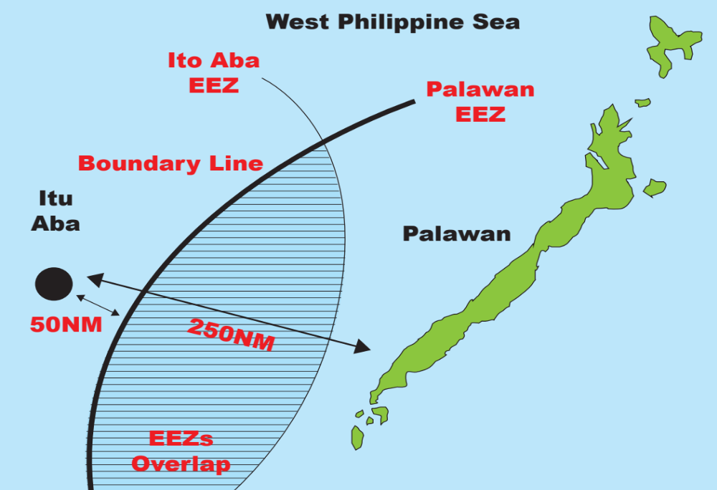
Opposite Coastlines: Palawan with 650KM coastline, and Itu Aba with 1km coastline

Slide 27
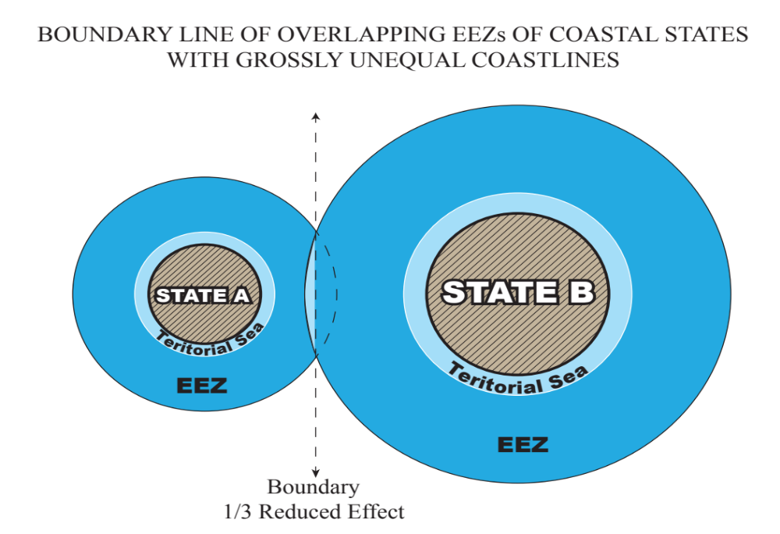
Overlapping EEZs

Slide 28
Protecting the nation’s maritime wealth in the West Philippine Sea
If the tribunal rules that Itu Aba generates an EEZ, the Philippines will then file a second case against China, this time for compulsory conciliation over the maritime boundary delimitation between China’s EEZ in Itu Aba and the Philippines’ EEZ in Palawan. Under UNCLOS, states that opt out of compulsory arbitration in maritime delimitation of sea boundaries cannot opt out of compulsory conciliation. While the report of the conciliation commission is non-binding, it will have persuasive authority as the equitable boundary delimitation under international law.
In China’s dispute with Japan over the Japanese-held Senkaku Islands in the East China Sea, China claims that the largest Senkaku island - Uotsurishima - with an area of 430 hectares, does not generate an EEZ but only a 12 NM territorial sea because Uotsurishima cannot sustain human habitation of its own. In contrast, China claims that Itu Aba, which has an area of only 37.7 hectares, and Scarborough Shoal, whose largest rock has an area of not more than 3 square meters, each generate a 200 NM EEZ. Uotsurishima is 11.4 times larger than Itu Aba and 860,000 times larger than the largest Scarborough rock.

Slide 29
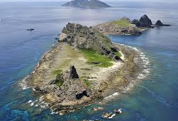
Senkaku Islands

Slide 30
Protecting the nation’s maritime wealth in the West Philippine Sea
This is not the only glaring inconsistency of China. China claims that the largest Japanese-held rock in Okinotorishima in the Philippines Sea, protruding about six inches above water at high tide with an area of less than 4 square meters, does not generate a 200 NM but only a 12 NM territorial sea because obviously Okinotorishima cannot sustain human habitation of its own. Yet China claims that Scarborough, which just as obviously cannot sustain human habitation of its own, generates a 200 NM EEZ.

Slide 31
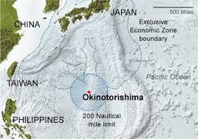
Okinotorishima

Slide 32
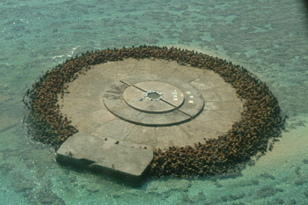
Okinotorishima - Preventing Erosion of Tiny Rock

Slide 33
Protecting the nation’s maritime wealth in the West Philippine Sea
China’s claim to a “historical right” to the waters enclosed within the 9-dashed lines in the South China Sea is utterly without basis under international law. This is the almost universal opinion of non-Chinese scholars on the law of the sea.
First, UNCLOS extinguished all historical rights of other states within the 200 NM EEZ of the adjacent coastal state. That is why this 200 NM zone is called “exclusive” – no state other than the adjacent coastal state can exploit economically its resources. Fishing rights that other states historically enjoyed within the EEZ of the adjacent coastal state automatically terminated upon the effectivity of UNCLOS.
UNCLOS prohibits states from making any reservation or exception to UNCLOS unless expressly allowed by UNCLOS. Any reservation of claims to “historical rights” over the EEZ or ECS of another coastal state is prohibited because UNCLOS does not expressly allow a state to claim “historical rights” to the EEZ or ECS of another state. In short, UNCLOS does not recognize “historical rights” as basis for claiming the EEZs or ECSs of other coastal states.

Slide 34
Protecting the nation’s maritime wealth in the West Philippine Sea
Second, under UNCLOS the term “historic bays” refers to internal waters, and the term “historic titles” refers to territorial seas. A state can claim “historical rights” over waters only as part of its internal waters or territorial sea. Under UNCLOS, a state cannot claim “historical rights” over waters beyond its territorial sea.
The South China Sea, beyond the 12 NM territorial sea of coastal states, has never been considered as the internal waters or territorial sea of any state. Ships of all nations have always exercised freedom of navigation in the South China Sea. Likewise, aircraft of all nations have always exercised freedom of over-flight over the South China Sea. China has stated that there is freedom of navigation and freedom of over-flight in the South China Sea, an admission that the waters enclosed within the 9-dashed lines do not constitute China’s internal waters or territorial sea.
The waters enclosed within the 9-dashed lines cannot also form part of China’s EEZ or ECS because they are not drawn from China’s baselines. China’s claim to the waters enclosed by the 9-dashed line claim does not fall under any of the maritime zones - internal waters, territorial sea, EEZ and ECS - recognized by international law or UNCLOS that could be claimed by a coastal state.

Slide 35
Protecting the nation’s maritime wealth in the West Philippine Sea
Third, under the general principles and rules of international law, a claim of “historical rights” to internal waters or territorial sea must satisfy four conditions.
  The state must formally announce to the international community such claim to internal waters or territorial sea, clearly specifying the extent and scope of such claim.
  The state must exercise effective authority, that is, sovereignty, over the waters it claims as its own internal waters or territorial sea.
  Such exercise of effective authority must be continuous over a substantial period of time.
  Other states must recognize, tolerate or acquiesce to the exercise of such authority.

Slide 36
Protecting the nation’s maritime wealth in the West Philippine Sea
China fails to comply with any of these four conditions. China officially notified the world of its 9-dashed line claim only in 2009 when China submitted the 9-dashed line map to the United Nations Secretary General. Not a single country in the world recognizes, respects, tolerates or acquiesces to China’s 9-dashed line claim. China has never effectively enforced its 9-dashed line claim from the time of China’s domestic release of its 9-dashed line map in 1947 up to 1994 when UNCLOS took effect, and even after 1994 up to the present.
Thus, under the general principles and rules of international law, China cannot claim any “historical right” that pre-dated UNCLOS. Even assuming, for the sake of argument, that China has such “historical right,” the entry into force of UNCLOS in 1994 extinguished such “historical right”. Under UNCLOS, a state cannot claim any “historical right” to the EEZ or ECS of another state.
China has tried to shore up its patently weak legal position with so-called “historical facts.” China claims that Scarborough Shoal, or Huangyan Island to the Chinese, is the Nanhai island that the 13th century Chinese astronomer-engineer-mathematician Guo Shoujing allegedly visited in 1279, having been ordered by Kublai Khan, the first emperor of the Yuan Dynasty, to conduct a survey of the Four Seas to update the Sung Dynasty calendar system.

Slide 37
Protecting the nation’s maritime wealth in the West Philippine Sea
Thus, the Chinese Embassy website in Manila claims:
    Huangyan Island was first discovered and drew (sic) into China's map in China's Yuan Dynasty (1271-1368 AD). In 1279, Chinese astronomer Guo Shoujing performed surveying of the seas around China for Kublai Khan, and Huangyan Island was chosen as the point in the South China Sea.
The alleged visit of Gou Shoujing to Scarborough Shoal in 1279 is the only historical link that China claims to Scarborough Shoal.

Slide 38
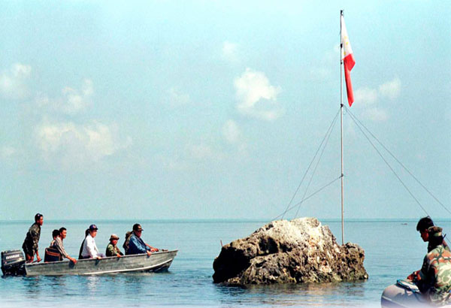
Scarborough
Shoal (Panatag)

Slide 39
Protecting the nation’s maritime wealth in the West Philippine Sea
However, in a document entitled China’s Sovereignty Over Xisha and Zhongsa Islands Is Indisputable issued on January 30, 1980, China’s Ministry of Foreign Affairs officially declared that the Nanhai island that Guo Shoujing visited in 1279 was in Xisha or what is internationally called the Paracels, a group of islands more than 380 NM from Scarborough Shoal. China issued this official document to bolster its claim to the Paracels to counter Vietnam’s strong historical claims to the same islands.
This Chinese official document, published in Beijing Review, Issue No. 7 dated February 18, 1980, states:
    Early in the Yuan Dynasty, an astronomical observation was carried out at 27 places throughout the country. In the 16th year of the reign of Zhiyuan (1279) Kublai Khan or Emperor Shi Zu, (sic) personally assigned Guo Shoujing, the famous astronomer and Deputy Director of the Astronomical Bureau, to do the observation in the South China Sea. According to the official History of the Yuan Dynasty, Nanhai, Gou’s observation point, was “to the south of Zhuya” and “the result of the survey showed that the latitude of Nanhai is 15°N.” The astronomical observation point Nanhai was today’s Xisha Islands. It shows that Xisha Islands were within the bounds of China at the time of the Yuan dynasty. (Emphasis supplied)

Slide 40
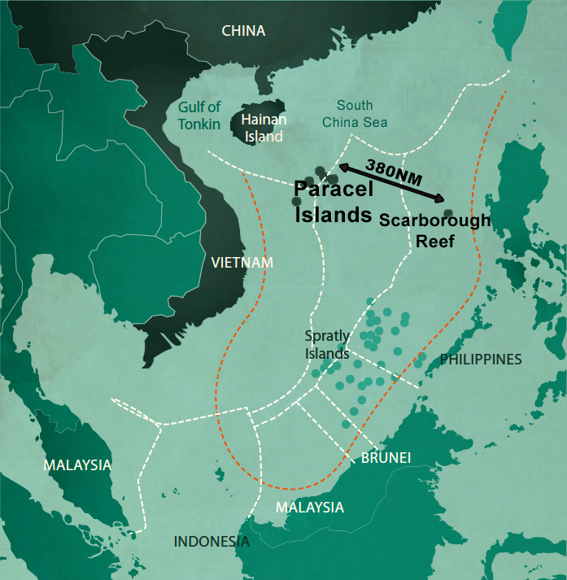
Paracels

Slide 41
Protecting the nation’s maritime wealth in the West Philippine Sea
China has officially declared that Nanhai island is in the Paracels, and thus China can no longer claim that Scarborough Shoal is the Nanhai island that Gou Shoujing visited in 1279. The Chinese historical account that Guo Shoujing installed one of the 27 Chinese observatories in Nanhai island clearly rules out any possibility that Scarborough is Nanhai island because no observatory could have possibly been physically installed on Scarborough Shoal at that time.
Based on the extant Gaocheng Observatory built in 1276 by Guo Shoujing in Henan Province, Guo Shoujing’s 27 observatories were massive 12.6 meters high stone and brick structures. The purpose of the observatories was to accurately determine the duration of the calendar year. To operate such an observatory, one had to visit the observatory every day of the year to take measurements. There was simply no way at that time that such an observatory could have been built and operated on the tiny rocks of Scarborough Shoal.

Slide 42
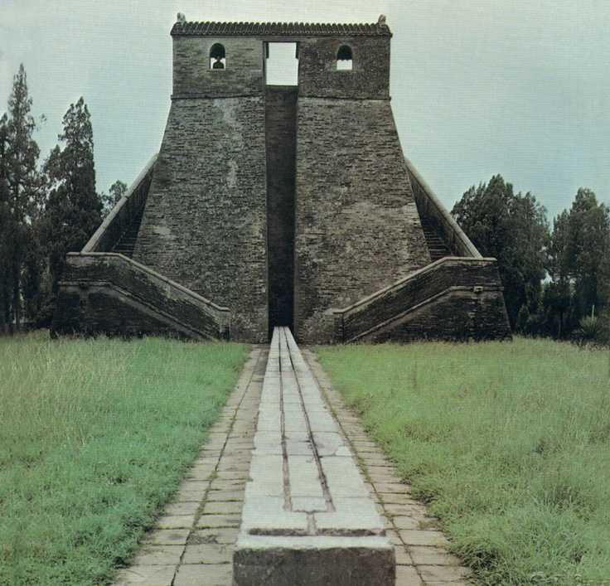
Gaocheng Observatory
China's oldest surviving observatory. Built in Henan Province around 1276 by renowned Chinese astronomer and engineer Guo Shoujing, it was used for time-keeping and mapping the stars. At the top of the 12.6-m observatory is a broad platform with two rooms which probably housed astronomical instruments. On the ground, a low wall with grooves allowed astronomers to measure the length of the Sun's shadow.

Slide 43
Protecting the nation’s maritime wealth in the West Philippine Sea
It is both physically and legally impossible for Scarborough to be Nanhai island - physically because no observatory could possibly have been installed in 1279 on the tiny Scarborough rocks, and legally because China has already officially declared that Nanhai is in the Paracels, more than 380 NM from Scarborough.
Another preposterous Chinese claim is that China’s southernmost territory is James Shoal, 50 NM from the coast of Bintulu, Sarawak, Malaysia. James Shoal is a fully submerged reef, 22 meters under water, entirely within Malaysia’s 200 NM EEZ and more than 950 NM from China. How did the fully submerged James Shoal become China’s southernmost territory?

Slide 44
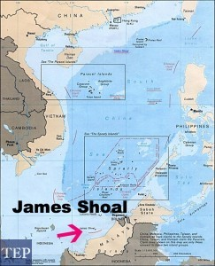
James Shoal

Slide 45
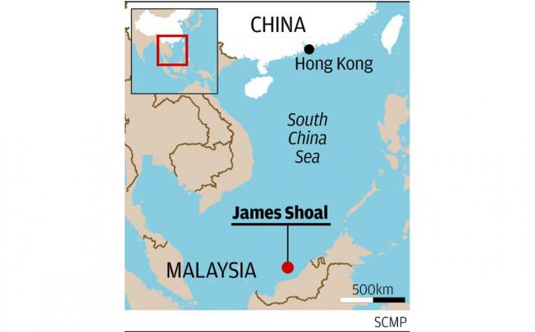
James Shoal

Slide 46
Protecting the nation’s maritime wealth in the West Philippine Sea
Let me quote a fascinating article published on February 9, 2013 in the South China Morning Post about James Shoal, written by Bill Hayton, a well-known British journalist:
    How did the Chinese state come to regard this obscure feature, so far from home, as its southernmost point? I've been researching the question for some time while writing a book on the South China Sea. The most likely answer seems to be that it was probably the result of a translation error.
    In the 1930s, China was engulfed in waves of nationalist anxiety. The predation of the Western powers and imperial Japan, and the inability of the Republic of China to do anything meaningful to stop them, caused anger both in the streets and the corridors of power. In 1933, the republic created the "Inspection Committee for Land and Water Maps" to formally list, describe and map every part of Chinese territory. It was an attempt to assert sovereignty over the republic's vast territory.

Slide 47
Protecting the nation’s maritime wealth in the West Philippine Sea
    The major problem facing the committee, at least in the South China Sea, was that it had no means of actually surveying any of the features it wanted to claim. Instead, the committee simply copied the existing British charts and changed the names of the islands to make them sound Chinese. We know they did this because the committee's map included about 20 mistakes that appeared on the British map - features that in later, better surveys were found not to actually exist.
    The committee gave some of the Spratly islands Chinese names. North Danger Reef became Beixian (the Chinese translation of "north danger"), Antelope Reef became Lingyang (the Chinese word for antelope). Other names were just transliterated so, for example, Spratly Island became Sipulateli and James Shoal became Zengmu. And this seems to be where the mistakes crept in.
    But how to translate "shoal"? It's a nautical word meaning an area of shallow sea where waves "shoal" up. Sailors would see a strange area of choppy water in the middle of the ocean and know the area was shallow and therefore dangerous. James Shoal is one of many similar features in the Spratlys.
    But the committee didn't seem to understand this obscure English term because they translated "shoal" as " tan" - the Chinese word for beach or sandbank - a feature which is usually above water. The committee, never having visited the area, seems to have declared James Shoal/Zengmu Tan to be a piece of land and therefore a piece of China.

Slide 48
Protecting the nation’s maritime wealth in the West Philippine Sea
Apparently, Chinese leaders and cartographers claimed James Shoal as China’s southernmost territory even without seeing or visiting James Shoal. Today, when Chinese naval vessels visit James Shoal, they would occasionally drop to the bottom of James Shoal cement and steel markers to designate China’s southernmost territory. This is contrary to UNCLOS, which prohibits any state from appropriating submerged features beyond its territorial sea. Not even Malaysia, whose coastline is just 50 NW away, can claim James Shoal as its sovereign territory.
Bill Hayton’s account of how James Shoal became China’s southernmost territory gives us an idea how dubious is China’s “historical facts” under its so-called 9-dashed line claim. China’s official proclamation in 1980 that Nanhai island is in the Paracels also exposes China’s false claim to any historical link to Scarborough Shoal.

Slide 49
Protecting the nation’s maritime wealth in the West Philippine Sea
All Chinese official maps during the Yuan, Ming and Qing Dynasties placed the southernmost border of China at Hainan Island. The famous 17th century Qing Dynasty Kangxi maps, prepared by the Jesuit missionaries who became advisers to Emperor Kangxi, placed Hainan Island as the southernmost border of China. None of the Chinese dynasty maps ever mentioned the Paracels, the Spratlys, Scarborough Shoal, the 9-dashed lines or the U-shaped lines. China itself claimed the Paracels only in 1932 and the Spratlys only in 1946 after World War II. In the 1951 San Francisco Peace Conference that produced the Peace Treaty of San Francisco, the victorious allies rejected a demand by the Soviet Union on behalf of China to turn over possession of the Paracels and Spratlys to China.

Slide 50
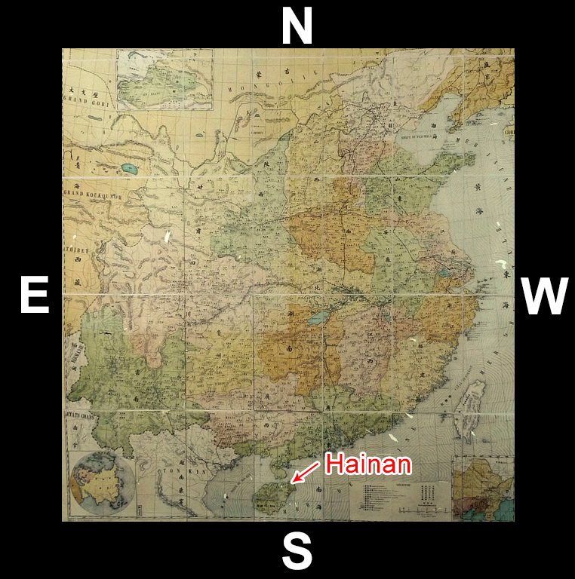
Kangxi
Map - Hainan as Southern-most Border

Slide 51
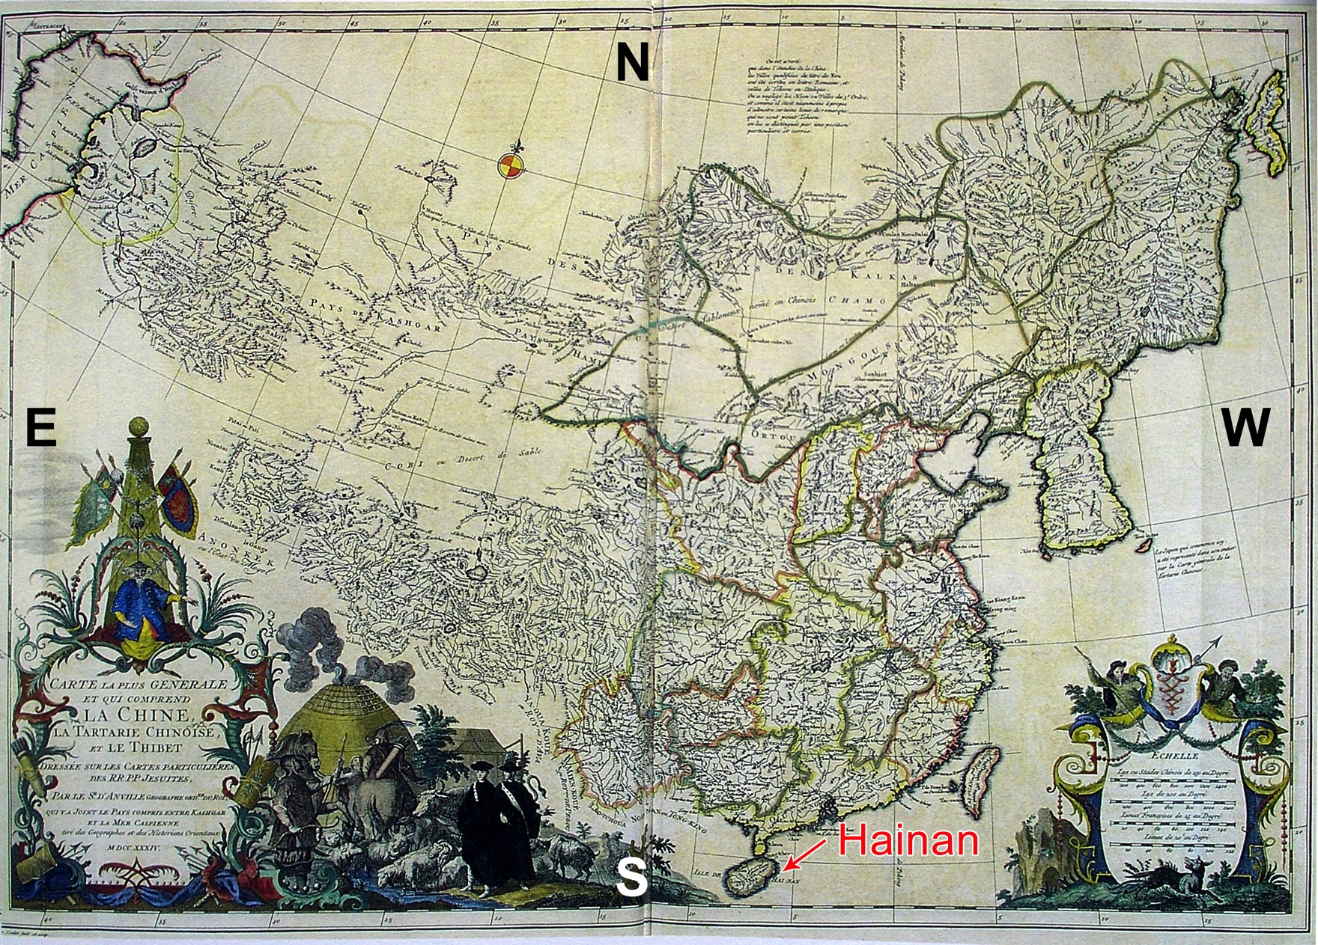
1734 Kangxi Map – Hainan as Southernmost Border

Slide 52
Protecting the nation’s maritime wealth in the West Philippine Sea
As late as in 1932, China has been telling the world that its southernmost border was Hainan Island. In a Note Verbale to the French Government on September 29, 1932 protesting the French occupation of the Paracels, the Chinese Government officially declared:
    Note of 29 September 1932 from the Legation of the Chinese Republic in France to the Ministry of Foreign Affairs, Paris
    On the instructions of its Government, the Legation of the Chinese Republic in France has the honor to transmit its Government’s reply to the Foreign Ministry’s Note of 4 January 1932 on the subject of the Paracel Islands.

Slide 53
Protecting the nation’s maritime wealth in the West Philippine Sea
    The Si-Chao-Chuin-Tao Islands, also known as Tsi-Cheou-Yang and called the Paracel Islands in the foreign tongue, lie in the territorial sea of Kwangtung Province (South China Sea); the northeast are the Ton-Chao Islands; the Si-Chao-Chuin-Tao Islands form one group among all the islands in the South China Sea which are an integral part of the territorial sea of Kwangtung Province.
    According to the reports on the Si-Chao-Chuin-Tao (Paracel) Islands drawn up in the Year XVII of the Chinese Republic (1926) by Mr. Shen-Pang-Fei, President of the Commission of Inquiry into these islands, and to the files of these islands compiled by the Department of Industry of Kwangtung Province, the islands lie between longitude 100°13’ and 112°47’ east. More than 20 in number, large and small, most of them are barren sandbanks, 10 or so are rocks and 8 are true islands. The eastern group is called the Amphitrites and the western group the Crescent. These groups lie 145 nautical miles from Hainan Island, and form the southernmost part of Chinese territory.
    xxxx (Emphasis supplied)

Slide 54
Protecting the nation’s maritime wealth in the West Philippine Sea
In short, in 1932 the Chinese Government officially declared to the world that China’s “southernmost part of Chinese territory” or border was Hainan Island. This declaration categorically affirmed the previous official maps of the Yuan, Ming and Qing Dynasties that showed Hainan Island as the southernmost territory or border of China. James Shoal, 800 NM away from the Paracels and 950 NM from Hainan Island, was never in Chinese history the southernmost territory or border of China.
The same is true for Scarborough Shoal, which is 380 NM from the Paracels and 500 NM from Hainan Island. Since Hainan Island or even the Paracels are the southernmost territory or border of China as officially declared by China in its September 29, 1932 Note Verbale to the French Government, then Scarborough Shoal is not part of, and could never have been part of, Chinese territory.

Slide 55
Protecting the nation’s maritime wealth in the West Philippine Sea
The oldest map in the world depicting Scarborough Shoal is the Murillo map that was first issued in 1734 during Spanish regime. The Murillo map, entitled Mapa de las Islas Filipinas, was made by the Spanish priest Fr. Pedro Murillo. The Murillo map clearly shows Scarborough Shoal, at that time called Panacot, lying just across Zambales. Panacot was the name given by Filipino fishermen to Scarborough Shoal during the Spanish regime.

Slide 56
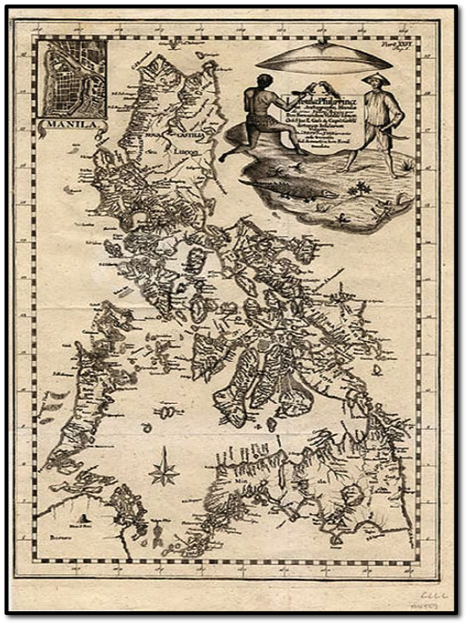
Murillo Map was first issued in 1734

Slide 57
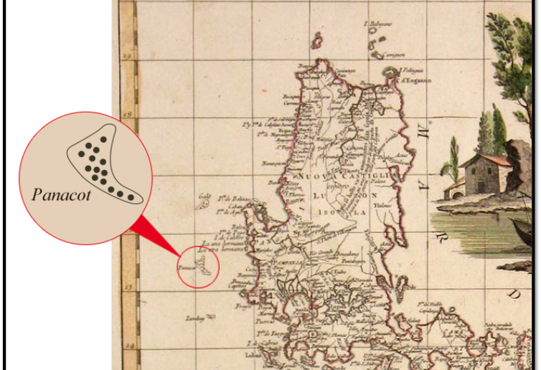
Another Murillo Map Showing Panacot (Scarborough)

Slide 58
Protecting the nation’s maritime wealth in the West Philippine Sea
The real and unvarnished historical facts in the South China Sea are quite different from what China has claimed them to be. Despite its name, which was given by European explorers and cartographers, the South China Sea was never the sole domain of China or of any one country. Even if we go back to the Sung Dynasty, we find the early Filipinos already sailing across the South China to trade with the Chinese along the coast of Canton in mainland China.
A noted Chinese scholar during the Yuan Dynasty, Ma Tuan-lin, wrote in his book A General Investigation of the Chinese Cultural Sources, about traders from the Philippines, which the Chinese at that time called Mo-yi or Ma-i. Ma Tuan-lin stated in his book, published in 1322 during the Yuan Dynasty and republished in 1935 in Shanghai:

Slide 59
Protecting the nation’s maritime wealth in the West Philippine Sea
  There were traders of the country of Mo-yi carrying merchandise to the coast of Canton [for sale] in the seventh year of Tai-ping-shing-kuo [of the Sung Dynasty, that is 982 A.D.].
As early as 982 A.D., Filipino traders were masters of the South China Sea, sailing back and forth from the Philippines to China to trade, more than 400 years before the Chinese Imperial Admiral Zeng He launched his famous sea voyages from 1405 to 1433 A.D.
China has been dangling to the Philippines and other claimant states its offer for joint development of the disputed areas while shelving the sovereignty issues, an idea suggested by their Chinese paramount leader Deng Xiaoping. There are at least three problems to this offer.

Slide 60
Protecting the nation’s maritime wealth in the West Philippine Sea
First, China wants to jointly develop the EEZ of the Philippines but refuses to jointly develop China’s own EEZ. China is saying to the Philippines, what is exclusively the Philippines economic zone belongs to both China and the Philippines, but what is exclusively China’s economic zone is China’s alone, and if the Philippines does not agree, Chinese warships will be there to prevent the Philippines from exploiting its exclusive economic zone.
Second, China’s offer of joint development is subject to the precondition that participating coastal states must first expressly recognize China’s “indisputable sovereignty” under its 9-dashed line claim. This precondition effectively means that once a state agrees to joint development, it must not only vacate any island it possesses in the Spratlys and turn over the same to China, it must also renounce any maritime claim within the 9-dashed line area. This precondition demanded by China is obviously inconsistent with its offer to shelve the sovereignty issue.

Slide 61
Protecting the nation’s maritime wealth in the West Philippine Sea
Third, if the Philippines agrees to China’s joint development offer, the Philippines will be giving up its exclusive “sovereign rights” to exploit all the living and non-living resources within its own EEZ. This is constitutionally impermissible because our 1987 Constitution mandates, “The State shall protect the nation’s marine wealth in its archipelagic waters, territorial sea and exclusive economic zone, and reserve its use and enjoyment exclusively to Filipino citizens.” Indeed, any joint development with China constitutes a “culpable violation of the Constitution.”
Not one of the claimant states to the Spratlys has accepted China’s joint development offer. Acceptance of China’s joint development offer means a complete surrender to China’s outlandish “indisputable sovereignty” claims. In an article in The Diplomat dated February 28, 2014, Prof. Carl Thayer, a well-known regional security analyst, quoted how a Malaysian defense official viewed China’s joint development offer.
        Nor are we ready to consider joint development activities with the Chinese. That would require recognition of China’s claims in the South China Sea, including our EEZ. And that’s not our policy.
        (Emphasis supplied)

Slide 62
Protecting the nation’s maritime wealth in the West Philippine Sea
Vietnam has a similar view of China’s joint development offer. Dr. Tran Troung Tuy, Director of the Centre for South China Sea Studies at the Diplomatic Academy of Vietnam, interprets the Chinese offer as saying: ”What is mine is mine, what is yours is mine and we are willing to share.”
That the use and enjoyment of our EEZ is reserved exclusively to Filipino citizens does not mean that Chinese companies cannot participate in the exploitation of oil and gas in our EEZ. They can but only as technical and financial contractors of the Philippine Government or Filipino companies under Philippine law, not Chinese law. As such technical contractors and financial contractors, they may be paid in kind. This is actually the set-up in Malampaya where Shell, a wholly-owned foreign company, is the technical and financial contractor of the Philippine Government under Philippine law.

Slide 63
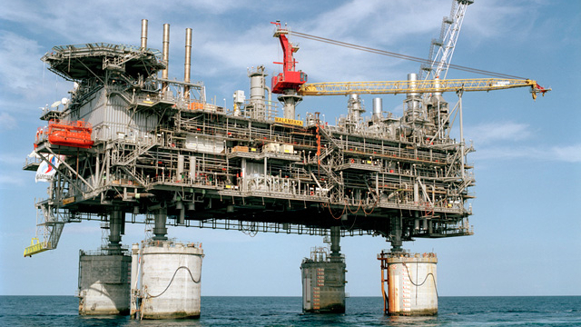
Malampaya Gas Platform

Slide 64
Protecting the nation’s maritime wealth in the West Philippine Sea
The world is now familiar with the expansionist designs of China in the South China Sea. China’s creeping invasion of the islands, rocks and reefs, as well as of the waters, of the South China Sea grows in force and aggressiveness each day as China’s naval forces assume greater superiority over those of other coastal states. The Philippines is particularly vulnerable to Chinese bullying because the Philippines has the weakest navy among all the major disputant states in the South China Sea.
The Philippines lost Mischief Reef in 1995 and Scarborough Shoal in 2012 to Chinese invasion. Vietnam lost the Paracels in 1974 and Fiery Reef Cross in 1988 to Chinese invasion. China, as I speak, threatens to forcibly evict the handful of Philippine marines aboard the shipwrecked RPS Sierra Madre in Ayungin Reef, an LTE within the Philippines’ EEZ in the Spratlys.

Slide 65
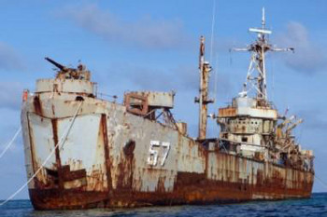
RPS Sierra Madre in Ayungin Reef

Slide 66
Protecting the nation’s maritime wealth in the West Philippine Sea
The world should now remind China of Deng Xiaoping’s solemn commitment to the world when he declared in his speech before the United Nations General Assembly on April 10, 1974:
    A superpower is an imperialist country which everywhere subjects other countries to its aggression, interference, control, subversion or plunder and strives for world hegemony. xxx If one day China should change her color and turn into a superpower, if she too would play the tyrant in the world, and everywhere subject others to her bullying, aggression and exploitation, the people of the world should identify her as social-imperialist, expose it, oppose it and work with the Chinese people to overthrow it. (Emphasis supplied)

Slide 67
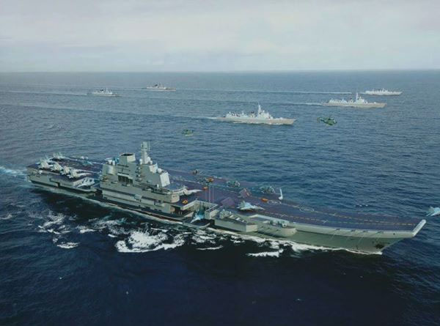
Chinese Aircraft Carrier Group

Slide 68
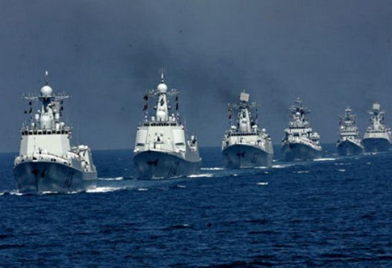
Chinese Warships

Slide 69
Protecting the nation’s maritime wealth in the West Philippine Sea
China’s rulers today have transformed China into the imperialistic hegemon that Deng asked the Chinese people and the world to fight and overthrow should China’s rulers in the future deviate from his vision of a peaceful and law-abiding China. Deng had repeatedly promised the world that China would “never seek hegemony”. Sadly for Deng, and sadly for the rest of the world, and most especially to Filipinos, that day has come.
In summary, the Philippine state has the constitutional obligation to protect its marine wealth in its EEZ. The Philippine Government is fulfilling this constitutional duty by filing the arbitration case against China under UNCLOS. The Philippines is entitled under UNCLOS to a full 200 NM EEZ in the West Philippine Sea. China’s 9-dashed line claim is patently invalid for being contrary to UNCLOS. Any joint venture with China under its terms will constitute a “culpable violation of the Constitution,” a sell-out of our national patrimony. Pursuing the arbitration case against China is necessary to reserve the use and enjoyment of our marine wealth in our EEZ exclusively to Filipinos, as mandated by the Constitution.

Slide 70
Thank you and a pleasant day to all.

